Slide 1


Mkulima Link APP Kenya
Slide Deck Pitch
Team Members
Brian Bosire
Faith Njuguna

Slide 2
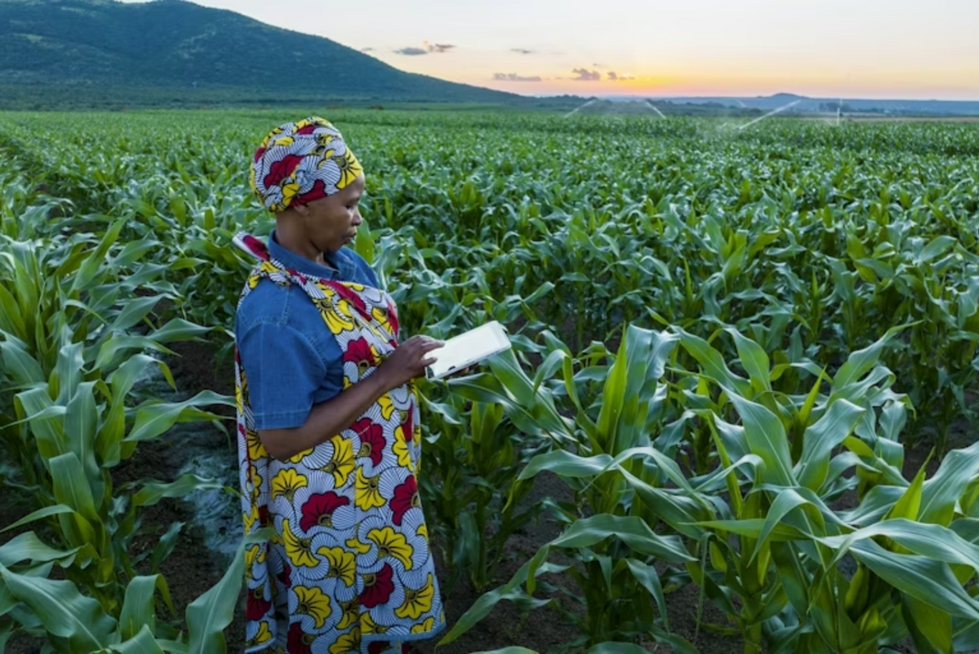

Problem Statement
Limited access to agricultural technology and digital tools hinders smallholder farmers in Kenya from adapting to climate change.
Why it Matters
Limited access to digital agricultural tools prevents smallholder farmers in Kenya from adapting effectively to climate change.
Empowering them with affordable, locally adaptable technologies is essential to improve productivity, resilience, and food security.
Martin Harvey/Getty Images

Slide 3
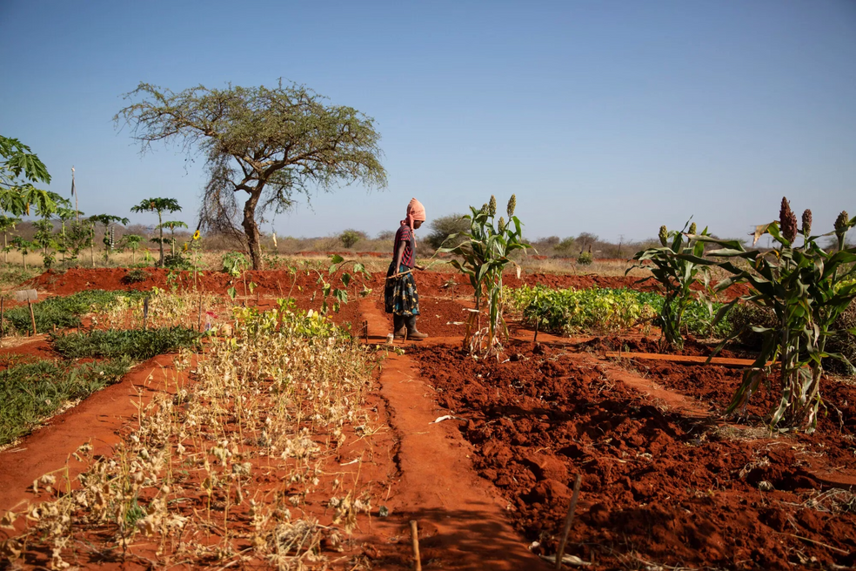
Affected Groups or Persons
Smallholder Farmers in Rural Kenya
Research Organizations
Government Institutions
Households facing food insecurity
Environmentalists
Policy Makers
Photo Credit: Ingebjørg Kårstad | Credit: Ingebjørg Kårstad/NRC

Slide 4
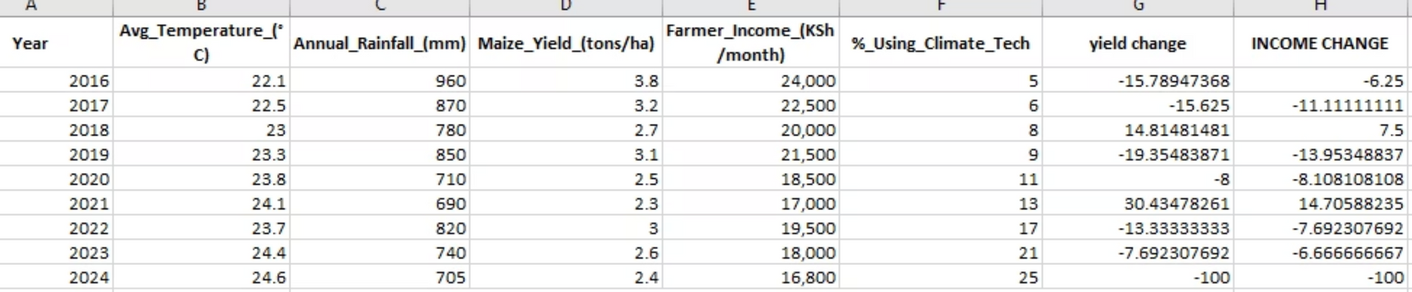
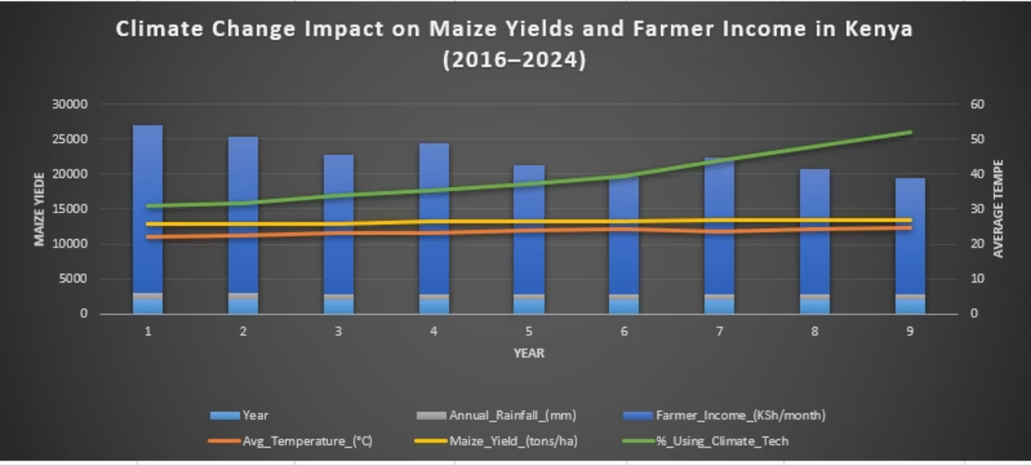
Case Study
Climate change impact on maize yields and farmers income

Slide 5
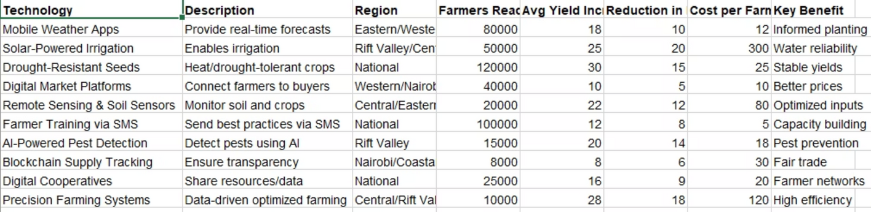
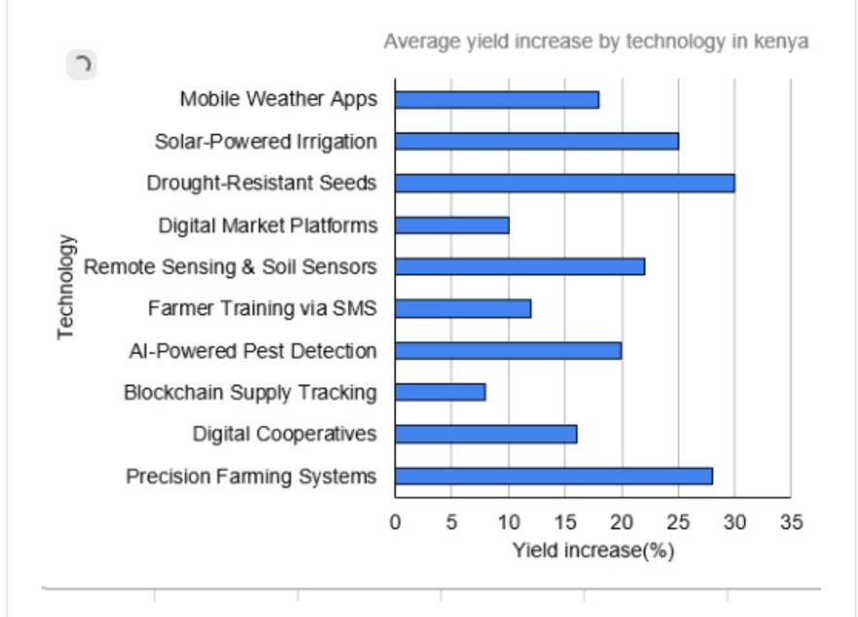
Yield Increase by Use of Technology
Technology is seen to boost average yields.
Farmers get real-time weather updates that help them plan and manage their agricultural activities.
Use of Artificial Intelligence that helps farmers detect pests, get recommendations of various pesticides to use is of great help and has boosted average yields.
Incorporating Technology and Agriculture is very crucial towards eradicating food insecurity.

Slide 6
Our Solution: Why Mkulima Link Kenya App
Mkulima Link Kenya is a mobile based app that provides farmers with access to Real time Weather Updates, AI Pest detection feature, Market Pricing and connection to buyers and the market, and not to forget a community forum that enables farmers to ask questions based on the issues they are facing and get expert guidance from qualified professionals and fellow farmers.
This Solution comes in handy with lot's of benefits to farmers and will help eradicate food insecurity and boost sustainable development in farming and business among small scale farmers in Kenya.

Slide 7
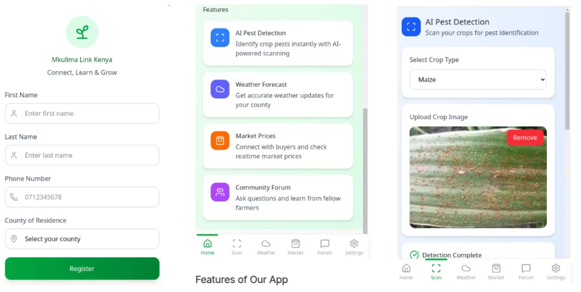
Mkulima Link Kenya App

Slide 8
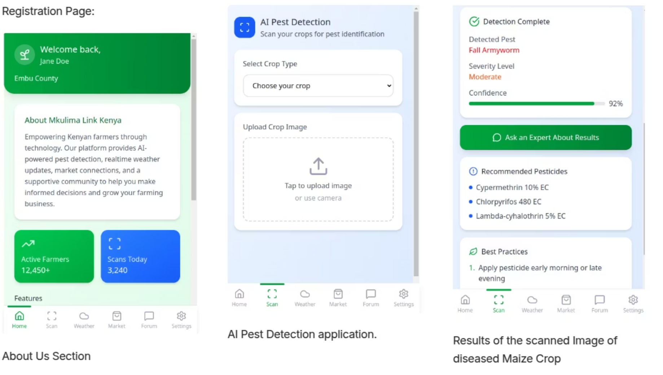

Slide 9
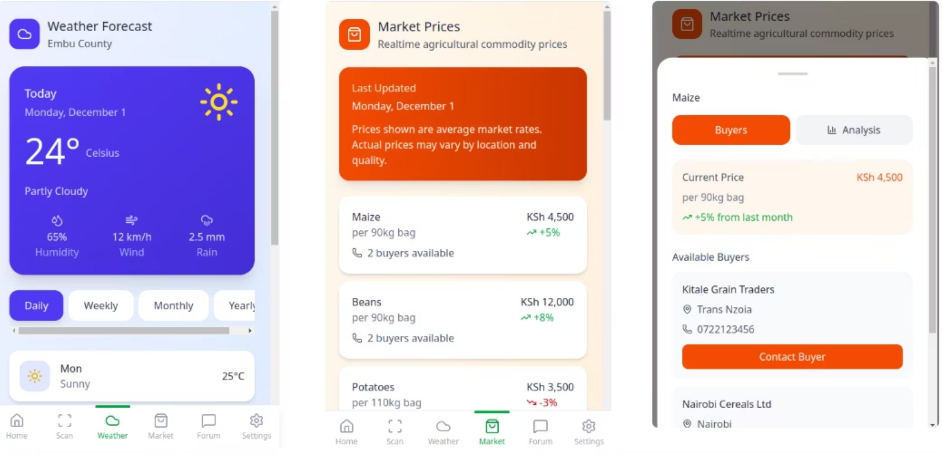

Slide 10
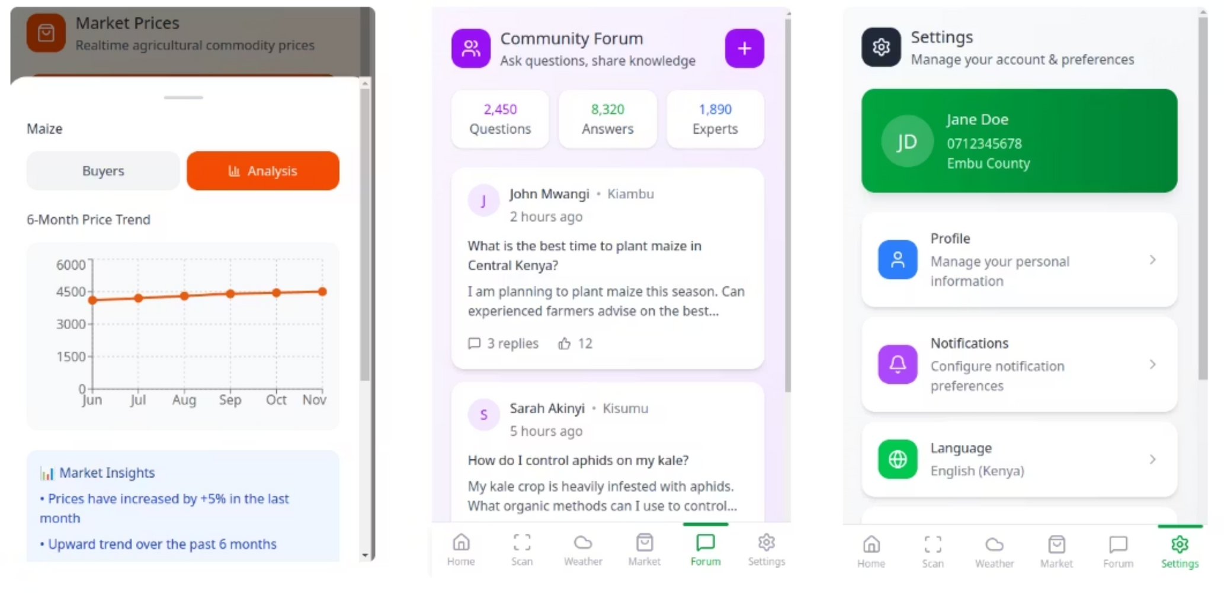

Slide 11
Pain Points of the Users
Next Steps if App is funded
Limited Market Access- Farmers struggle to find reliable buyers or fair prices for their produce.
Collaborate with agricultural and meteorological partners to improve data accuracy and expand reach.
Information Gap- Lack of access to timely agricultural tips, weather updates, and modern farming techniques.
Enhance and finalize the mobile app’s features by focusing on AI image recognition, real-time alerts, and market price updates.
Inefficient Communication- Poor coordination between farmers, suppliers, and transporters.
Conduct pilot testing in key farming regions to collect user feedback for refinements.
Low Digital Literacy Some users may find digital tools difficult to navigate without training.

Slide 12
Why
Empowers Smallholder Farmers: The app gives farmers easy access to real-time weather updates, market prices, and farming advice so as to be helping them make informed decisions.
Bridges the Digital Divide: It provides affordable, user-friendly technology (with offline SMS access) for farmers in rural areas who have limited internet or digital skills.
Promotes Climate Resilience: By sharing timely data and alerts, the app helps farmers adapt to climate change and improve their productivity and income.

